Slide 1
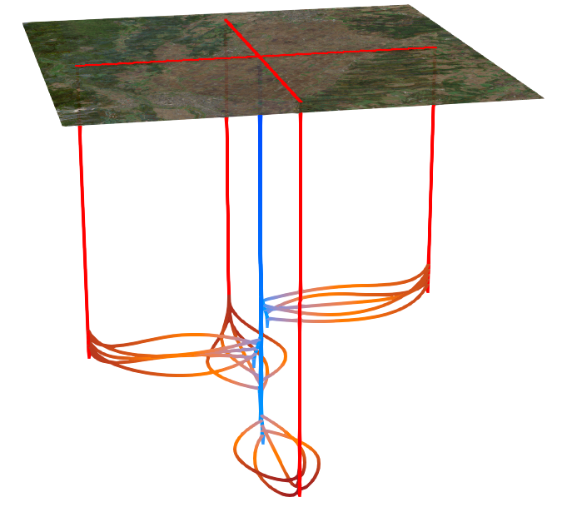
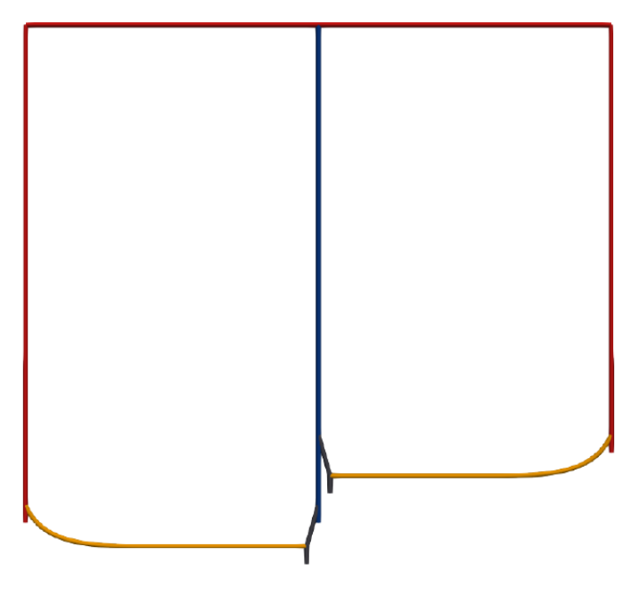

Radial Closed-Loop Geothermal Architectures for Phased Scaling: Thermal Performance Study
Samuel Tellier
Tellier Dynamics Corp.
Notes:
We are moving from a 'Radiator' mindset, monolithic and linear, to a 'Network' mindset—modular and radial. This is the Telluric Radial System.

Slide 2
Overview
Why pursue closed-loop?
AGS / lateral array economic problems
AGS / lateral array economic solutions
Technical challenges / solutions
Phased-Scaling Vision
Phased Scaling Visualizations
The Enabler: Downhole Isolation Node
Architecture
Methodology Benchmarking Against Existing State-of-Art Solution
Thermal Performance Results
Hydraulic Feasibility and Parameter Sensitivity Analysis
Conclusions
Next Steps
Questions

Slide 3
Why Closed Loop? (Not EGS)
No Induced Seismicity Risk
Resistant to seismicity (Eavor™ NL report)
Lower risk / uncertainty. Predictable
Utilize electrical power AND thermal heat
Simpler + cheaper surface infrastructure
No fluid loss (tiny amounts)
Passive flow with thermosiphon
Viable in seismically and environmentally sensitive geographies

Slide 4
Why Lateral Arrays? (Not Coaxial BHEs)
Increased deep + hot contact area per drilled meter
Physically separated injection and production flows (minimal interference)
More subsurface horizontal area => more replacement through natural heat flux

Slide 5
AGS / Lateral Array Economic Problems
Drill all laterals before generating a single Watt => high CAPEX risk + long time to revenue
Surface contact area is proportional to lateral length, long laterals are expensive
Circulating mud causes premature thermal drawdown and increases rebound time
Close proximity laterals thermally interfere. Spreading multi-laterals apart increases turn dog-leg severity
Geology fails -> output declines or shut down entire loop for intervention
Notes:
Standard loops require multiple years and 100% of CAPEX for a before the first watt. That is binary risk. Then, if the geology fails (i.e. a lateral collapses or leaks), the entire loop must be shut down for an intervention.

Slide 6
AGS / Lateral Array Economic Solutions
Drill all laterals before generating a single Watt => high CAPEX risk + long time to revenue
* Add and enable laterals in phases
Surface contact area is proportional to lateral length, long laterals are expensive
* Cost dominated by rig time (esp. In hot rock) => drill fast
Circulating mud causes premature thermal drawdown and increases rebound time
* Minimize mud usage (Enablement: Non-Contact Drilling eliminates thermal skin effect.)
Close proximity laterals thermally interfere. Spreading multi-laterals apart increases turn dog-leg severity
* Multiple outflows achieve “radial” lateral spacing
Geology fails -> output declines or shut down entire loop for intervention
* Isolate / control lateral flows individually or in subgroups

Slide 7
Technical Challenges / Solutions
Active Magnetic Ranging detection distances <130m make well intersections complex
* “Lighthouse” strategy doubles effective AMR range
Active Magnetic Ranging uncertainty approx. 5-10% at medium to long ranges
* Aim/MWD -> AMR -> PMR
Lateral length limited by increased friction reducing weight on bit
* mmwave (Quaise) drilling requires significantly lower weight on bit => longer laterals feasible

Slide 8
Live-Expansion Vision
Vertical Trunk: Drill via Mechanical or MMW.
Build Section: Use RSS to build inclination.
  Waveguide Constraint: Utilize Long-Radius build (<3°/30m) to accommodate MMW physics.
Launch: Flasked gyro alignment to establish MMW launch vector.
Primary Target: Direct intersection with Downhole Isolation Node.
Ideally intersect the downhole isolation node directly
Contingency A (Near-Miss): Short-range abrasive jetting
Contingency B (Far-Miss): Switch to Mechanical RSS + Active Magnetic Ranging -> Passive Magnetic Ranging for guided intercept.
Flush & Activate: Live node bootstraps power & revenue for next lateral phase.

Slide 9
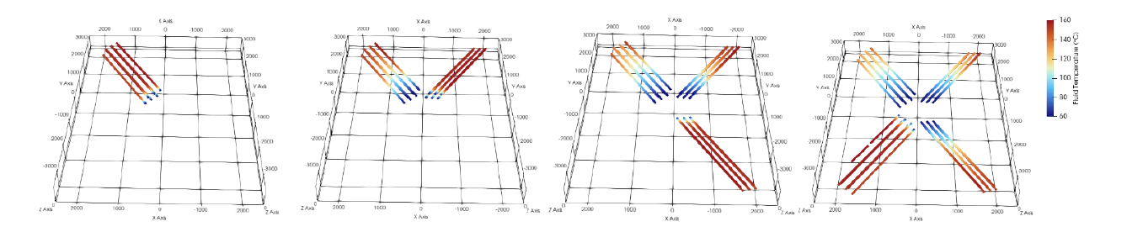
Phased Scaling Visualization
Add Isolated Lateral Sets in Stages
3 months
6 months
9 months
12 months
Notes:
TRS changes the IRR equation. We drill the Hub and 3 laterals. We turn it on. We generate cash and prove baseload power. The asset starts funding its own expansion.

Slide 10
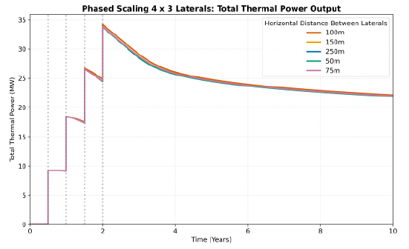
Phased Scaling Power Graph
Add Isolated Lateral Sets in Stages
4 Outflows Added
Revenue Generation
Reference Loop Revenue Generation

Slide 11
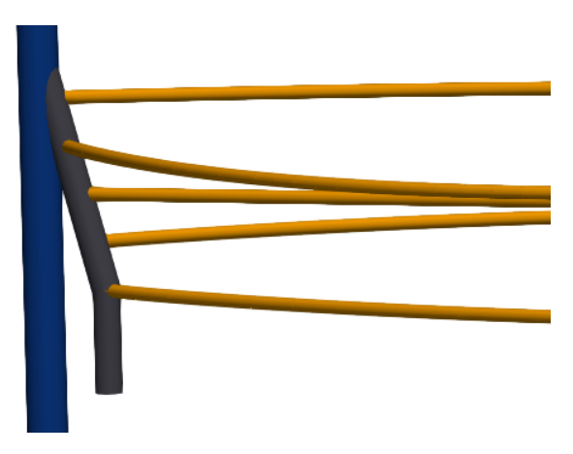
The Enabler: The Downhole Isolation Node
(Patent Pending)
Nodal Isolation for Live-Well Interception
Dual Barrier System for Drilling Safety Redundancy
Throttling enables ‘Thermal Rebalancing’
Injector Well
Downhole Isolation Node
Magnetic Ranging Target(s)
Debris Sump
Abstract Depiction of a Downhole Isolation Node (dark gray) With 5 Lateral Connections (yellow)
Notes:
Phased scaling is only possible if you can connect to a live well. This is our core IP: The Downhole Isolation Node. It allows us to mechanically dock new laterals into a the system and hydraulically connect them without shutting down the plant.

Slide 12
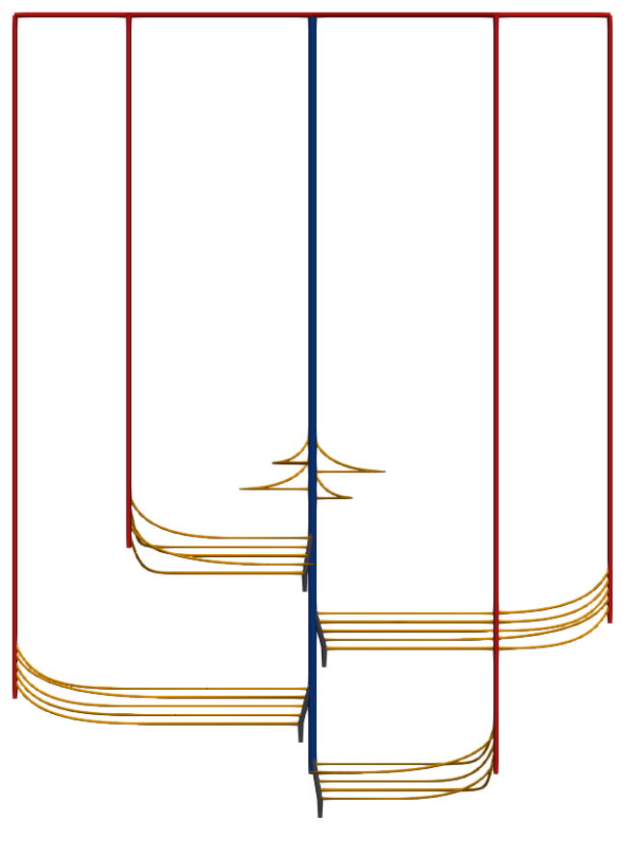
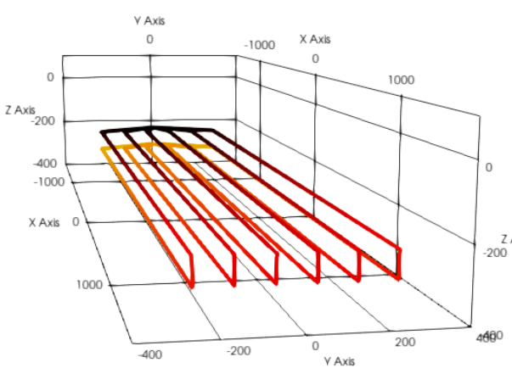
Risk Segmentation
Parallel Reliability vs. Serial Fragility
Hub = Engineering Risk (Single Point of Failure)
Laterals = Geological Risk (Compartmentalized to Downhole Isolation Nodes or to Outflows)
Notes:
This is the real winner. A standard loop is a series circuit—one blockage kills an entire lateral loop. The whole circuit might be shutdown for an intervention to fix one lateral. The TRS is a parallel circuit. If we lose a lateral, it’s half the loss. If we lose a radiator, it can be isolated to that radiator. Intervention operations like re-lining can be limited to a single outflow, while the others keep generating revenue. A modular approach compartmentalizes the geological risk. Critics will note the Hub is a Single Point of Failure. This is true. But we are trading Geologic Risk (unpredictable) for Engineering Risk (controllable). The Hub is steel and cement. We can engineer that. The Laterals are rock. That is where the risk is. If one lateral leaks, we isolate the issue to that outflow. The asset survives. We have compartmentalized the uncontrollable risk.

Slide 13
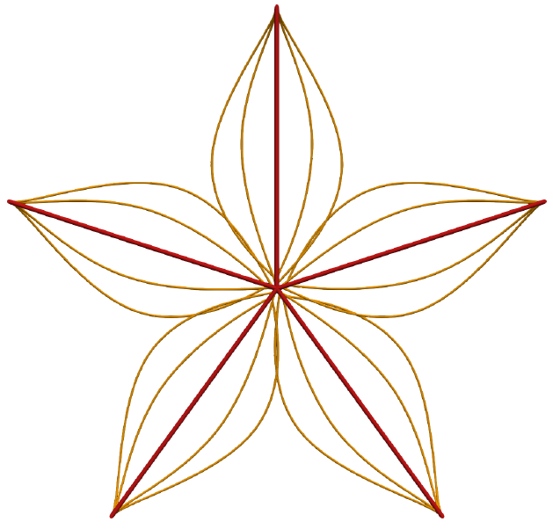
The Architecture: Hub-and-Spoke Topology
Minimized Interference via Horizontal & Vertical Staggering
Radially Distal Lateral Arrays Maximize Reservoir Utilization (per meter drilled)
Notes:
The concept is simple but effective: A central 'cold' injector feeding a radial array of 'hot' producers. This geometry allows us to access a massive cylindrical volume of rock from a single central asset, rather than being limited to linear corridors. Multiple producers provide an already-distributed heat network on the surface.

Slide 14
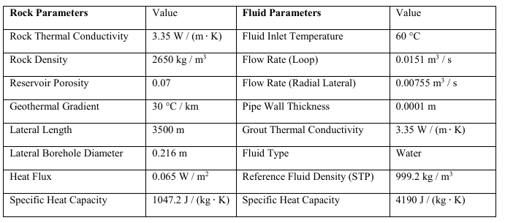
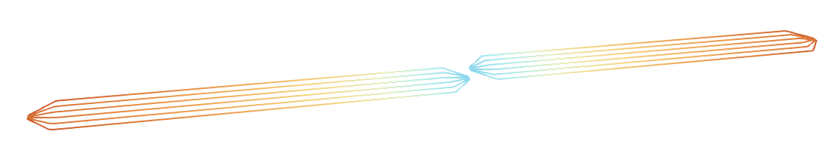
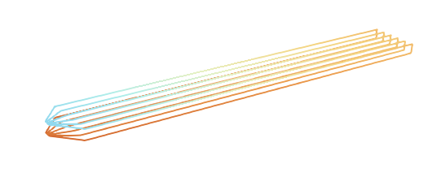
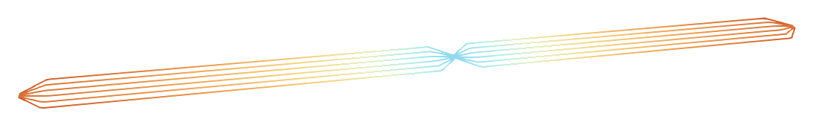
Benchmarking Methodology (GMSH, OGS 1P BHE)
Normalized for Total Drilled Meters & Mass Flow
Simulated Geretsried, Germany Conditions
TRS 2x6 Matched Depth
75m to 150m vertical offset to match reference
TRS 2x6 Max Depth
Reference Loop
Notes:
We benchmarked against the industry-standard stacked design (like Geretsried), normalizing for total drilled meters. Showing that the radial radiator pattern is thermodynamically efficient puts numbers on the benefits of solving its engineering constraints.

Slide 16
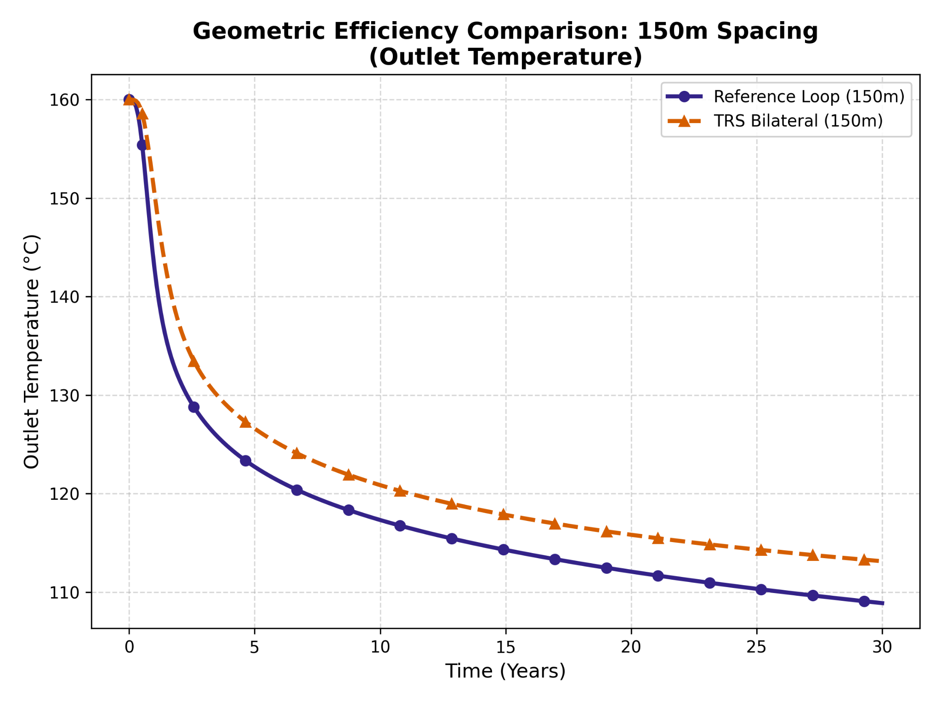
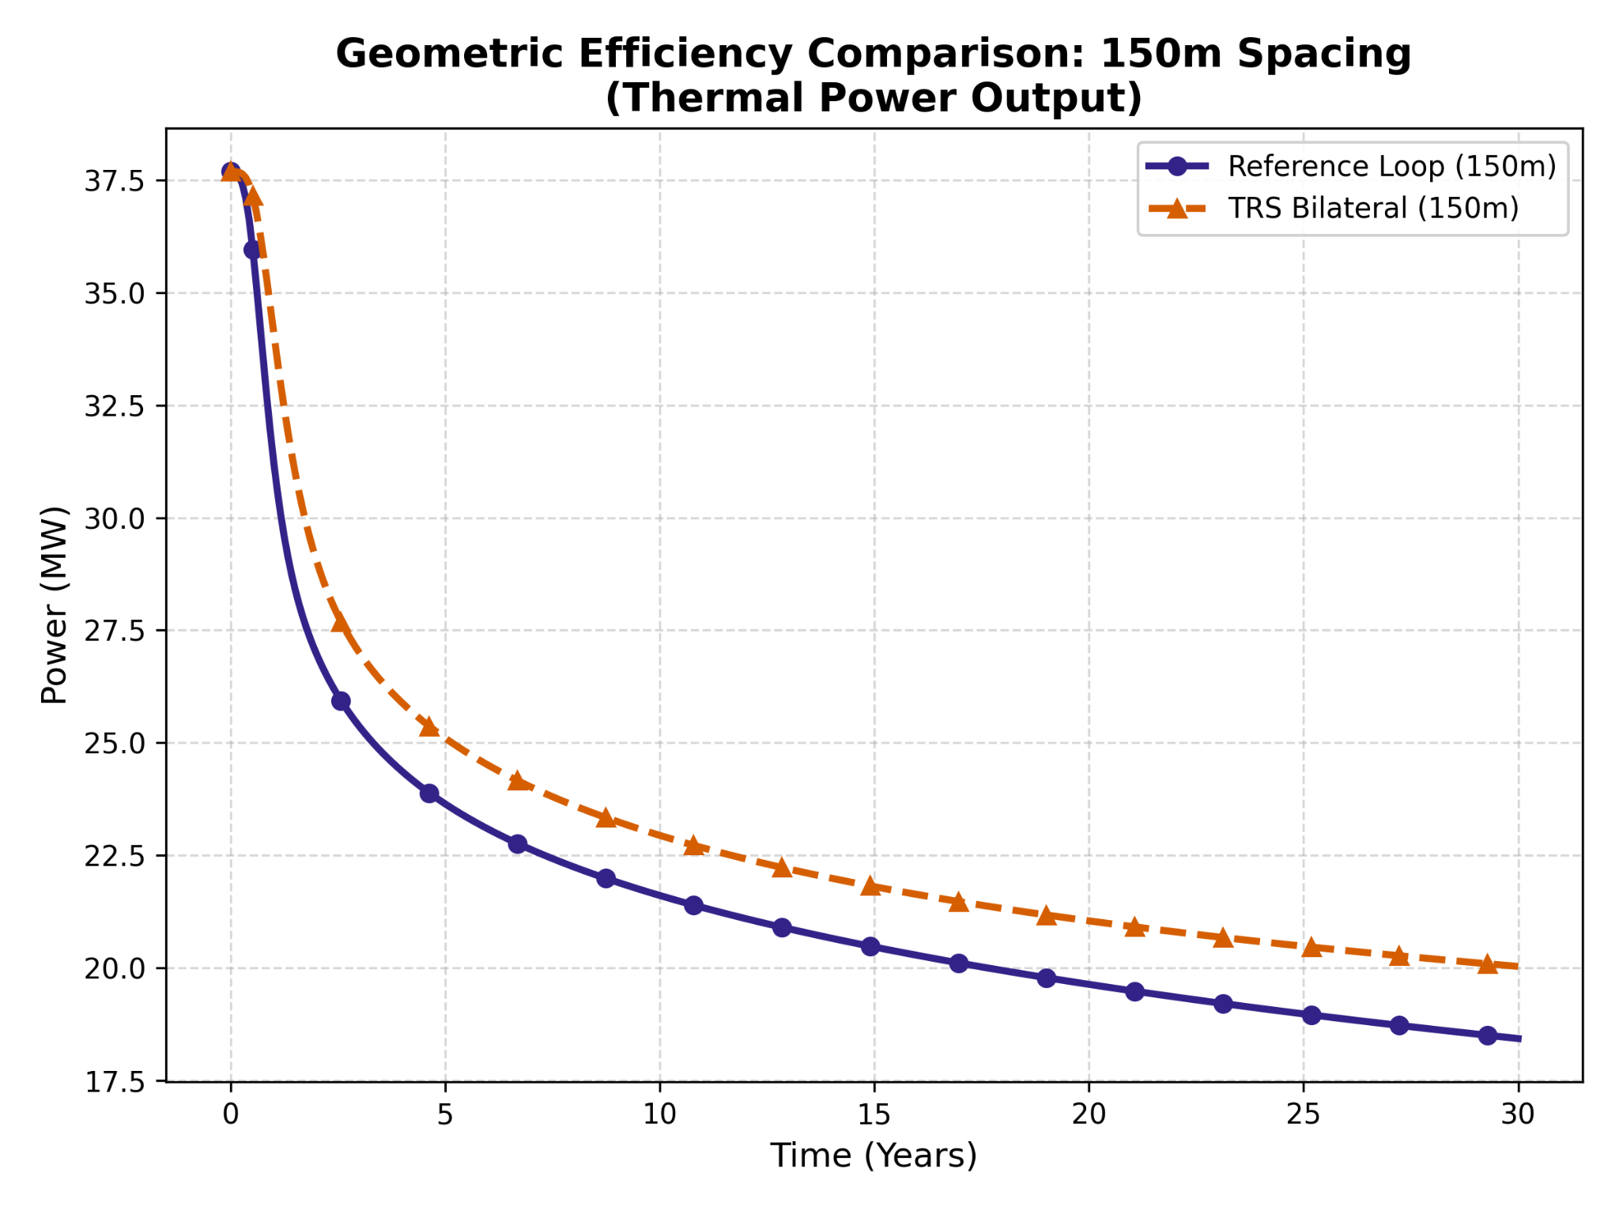
Long-Term Thermal Performance
Separating Stacks Maintains +5℃ Output After 30 Years
TRS 2x6
TRS 2x6
+5℃
Notes:
The TRS maintains a +5 degree C output after 30 years compared to the 75m vertical separation reference loop. The sweep on horizontal distance between laterals shows that as horizontal distance between laterals increases, the output temperature difference between the radial and reference cases increases. The single laterals are able to collectively utilize more of the usable reservoir volume.

Slide 17
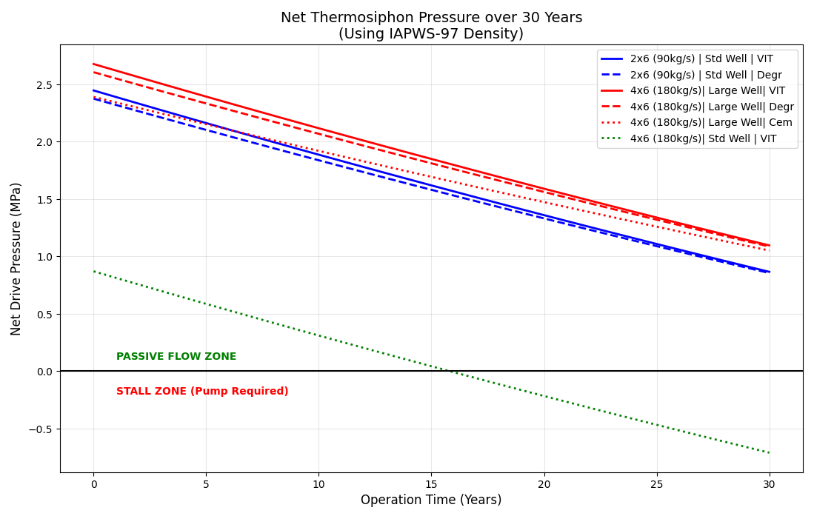
Hydraulic Feasibility
2x6 (90 kg/s): Passive Flow with 9-⅝" Casing
4x6 (180 kg/s): Friction Limits Require Parasitic Pumping with 9-⅝” Casing. Passive Flow with 13-⅜” casing.

Slide 18
Conclusions
Viable Today: TRS is executable immediately using the high-temp conventional drilling techniques validated by Gonzalez Luis et al. (2026).
Optimized for MMW: TRS is the only architecture designed to leverage Millimeter-Wave (MMW) drilling constraints as a feature. By utilizing long-radius geometries, we solve the steering bottleneck. When MMW arrives, CAPEX drops by ~50%, and unit economics become market-leading.
Geometric Advantage: Radial diverging topology minimizes the 'Thermal Interference' seen in parallel-stacked arrays. This allows TRS to access >2x more rock volume per well than stacked designs.
Risk Segmentation: Phased scaling allows for 'Live-Expansion.' We de-risk the reservoir in $10M or smaller increments (one 3-lateral set) rather than $100M+ 'All-or-Nothing' commitment.
Hydraulic Stability: Large-bore completions maintain >1 MPa buoyant drive at commercial flow rates (180 kg/s), eliminating parasitic pumping loads.
Operational Control: Proprietary Downhole Nodes enable active 'Thermal Rebalancing'. Cold laterals can be shut-in to accelerate startup and balance flow over time.

Slide 19
Next Steps
Phase 1 Pilot Roadmap: Shallow Hub + Single MMW Radial Lateral.
Techno-economic pairing of MMW Drilling Speed with TRS Phased Revenue.

Slide 20
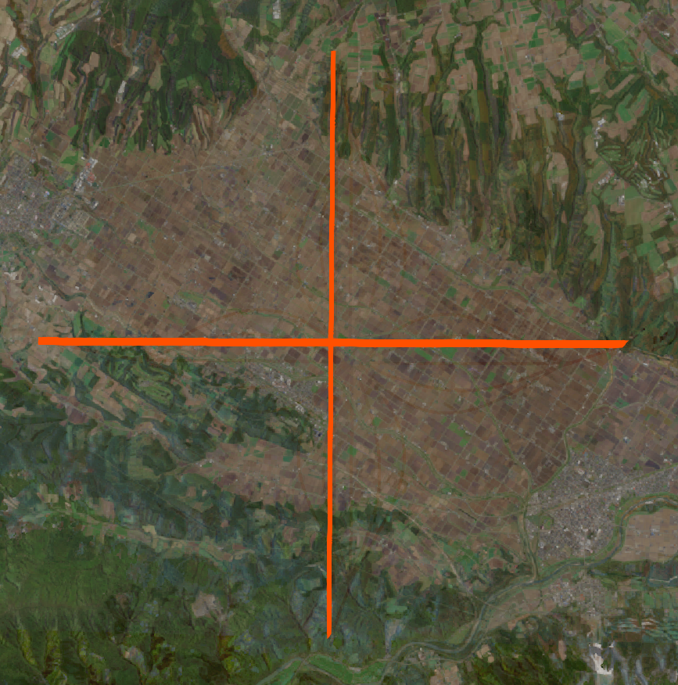
Power for People (and Data Centers)
Provides Built-In Thermal Perimeter for District Heating, Local Industry, Lateral Co-Location
Outflow
Injector
Fluid Return Pipe
District Heating
Data Centers
Agriculture
Local Industry
Notes:
Because our satellites are kilometers apart, we create a thermal perimeter. We can deploy heat directly into district heating and local industry at the satellite locations. Co-locating ORC generators with outflow wells can allow for more modular power generation to match localized demand.

Slide 21

The Future of Geothermal is Radial
sam@tellierdynamics.com
Tellier Dynamics, Seattle, WA USA
Scan to Download Paper & Slides
https://tellierdynamics.com

Slide 22
AI Disclosure
Several models were used for research, drafting, and coding tasks, most substantially Google Gemini. Results were verified by the author.

